Slide 1
Theory of Modeling and Simulation (M&S)
Dolors Sala
First Quarter
2017-18

Slide 2
What on theory?
Conceptual framework for:
Understand the real problem/scenario
What to interpret from the reality?
How to implement the model?
What to obtain from the model?
How to verify the model vs reality?
Goal: the simulation as a modeling, learning and designing tool

Slide 3
Bibliography
The slides are designed to assist the instructor’s presentation during the session, and not to be a complete material for study. It is recommended to take notes in class.
“Theory of Modeling and Simulation”, B. Zeigler, H. Praehofer, T.G. Kim, Academic Press, 2nd Ed. 2000. (Chapters 1,2)
“Simulation Modeling and Analysis”, A. M. Law, W. D. Kelton, Ed. McGrawHill, 3rd Ed. 2000. (Chapter 1, 3)

Slide 4
Modeling Terminology
System: the facility or process of interest
  To study scientifically a system we usually have to make a set of assumptions of how it works
Model: the set of assumptions that defines/characterizes the operations interested to study of a system
  It is used to try to gain some understanding of how the corresponding system behaves
Types of models
  Analytical when the set of assumptions are simple enough that can be expressed in mathematical methods (algebra, calculus, probability) to obtain exact information on questions of interest
  Simulation we use a computer to evaluate the model numerically and to gather data in order to estimate the desired true characteristics of the model

Slide 5
The Need of Modeling Methodology
Many simulation “studies” is done based on heuristic models, coding and a single run of the program to obtain “the answer”
This attitude that neglects the important issue of how a properly coded model should be used to make inferences about the system of interest, has doubtless let to erroneous conclusions being drawn from many simulation studies
Goal: the simulation as a modeling, learning and designing tool

Slide 6
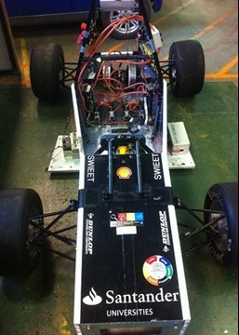
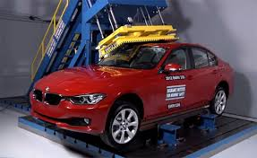
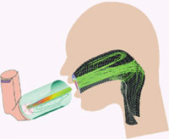
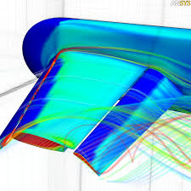
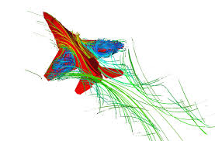
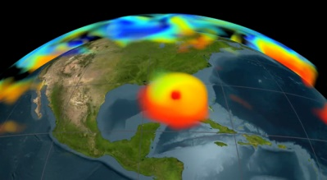
Ways to Study a System
System
Experiment
with the
actual system
Experiment
with a model
of the system
Physical
Model
Mathematical
Model
With just the output is not
possible to know if the model
is analytical or simulation or
combination of both
Analytical
Model
Simulation
Model
Plane Aerodynamics
Hurricane simulation
Aerosol Inhaler

Slide 7
Ways to Study a System:
Real System versus a Model
Experiment with the actual system
  When it is possible and cost-effective to alter the system physically and let it operate under new conditions
  There is no question whether what we study is valid, most of the times
    Must guarantee it is not disruptive (the study may change the actual behavior of the system)
Experiment with a model of the system
  The system may not exist yet
  There is the question of whether it accurately reflects the system for the purposes of the decisions to be made (validity)

Slide 8
Ways to Study a System:
Types of Models
Types of models
  Physical model: a physical reproduction of expected outcome (car, test-bed,…)
  Mathematical model: represent the system in terms of logical and quantitative relationships that are then manipulated and changed to see how the model reacts
    Analytical models can obtain an exact value of the system behavior
    Simulation models: exercising the model for the inputs to see how affect the output measures of performance
Hurricane simulation
Plane Aerodynamics
Aerosol Inhaler

Slide 9
Formal Aspects of Modeling

Slide 10
Basic Concepts
System: the collection of entities that act and interact together toward the accomplishment of some logical end
Attributes: the data values that characterize an entity
State of a system: the collection of attributes (variables) necessary to describe a system at a particular time, relative to the objectives of a study
Two types of systems
  Discrete System a system which the state variables change instantaneously at separated points in time
  Continuous System a system which the state variables change continuously with respect to time
  Few system are wholly discrete or wholly continuous but usually one type of them predominates

Slide 11
Formal Aspects of Modeling
Levels of System Specification
  Levels at which we can describe how systems behave and the mechanisms that make them work the way they do
Systems Specification Formalisms
  These are the types of modeling styles, such as continuous or discrete, that modelers use to build system models

Slide 12
System Specification
Behavior: outer manifestation
  Relationship between input-output data gathered from system
Structure: inner constitution
  State definition
  State transition mechanism
    How inputs modify current state to subsequent state
    State-to-output mapping
Knowing the system structure we can analyze (simulate) the system behavior
System
State
Input
Output

Slide 13
Levels of System Knowledge
At each level we know things about the system that we do not know at lower level
(Low:0 ) Source level
  What variables to measure and how to observe them
Data level
  Database of measurements and observations collected by the source system
Generative level
  Means to generate data in a data system (formula that reproduce measurements)
  When people talk about simulation they refer this level (a model means a program to generate data)
(High: 3) Structure level
  Level that describe how this generative data can be produced
  When people talk about systems they talk at this level

Slide 14
Structure Concepts
Decomposition: breaking a system in components
Composition: coupling components to build a larger system
Hierarchical Construction: continue to compose larger systems from previously constructed components
The hierarchical construction levels define the levels of system specification (a modular specification)
Notes:
Property: Systems theory is closed under composition
The structure and behavior of a composition of systems can be expressed in the original system theory terms
The closure property guarantees that the resultant system has a well-defined structure and behavior

Slide 15
Hierarchical System Decomposition
High Level
Low Level

Slide 16
Levels of System Knowledge :
Supermarket Example
Source level : What to collect
  Number of customer in line at particular times
Data level : Collected measurements
  Time to spent to pay
Generative level: Reproduce measurements (simulation)
  Mathematical model: Queuing system
Structure level: Reproduce system (system)
  Implement the customers and queues in a program

Slide 17
Fundamental Systems Problems:
The use of a simulation
System analysis: understand the behavior of an existing or hypothetical system based on its known structure
Systems inference: done when we don’t know the structure, we try to guess it from observations (model construction)
Systems design: investigating the alternative structures for a completely new system or redesign of an existing one
Reverse engineering involves first a system inference and then a (new) system design (most of the times to bypass existing patents)

Slide 18
Modeling and Simulation (M&S) Framework
Experimental Scenario
Source
System
Simulator
Behavior Database
Modeling
Relation
Model
Simulation
Relation
Notes:
I have changed the word frame for scenario to make it more understandable, understanding scenario as a subset of the real system components and behavior, not as an static snapshoot of the system.

Slide 19
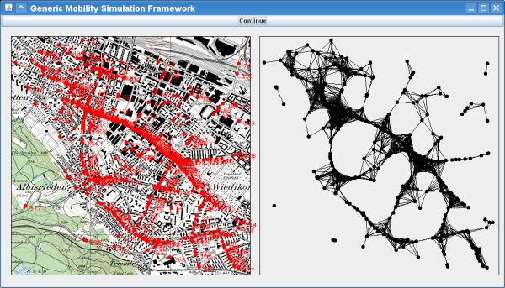
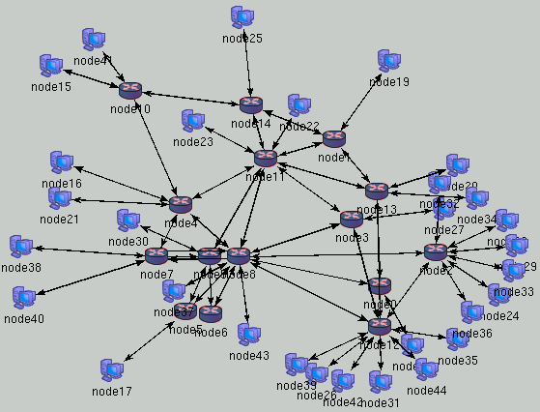
Modeling and Simulation (M&S) Framework
Experimental Scenario
Source
System
Simulator
Behavior Database
Modeling
Relation
Model
Simulation
Relation
Notes:
I have changed the word frame for scenario to make it more understandable, understanding scenario as a subset of the real system components and behavior, not as an static snapshoot of the system.

Slide 20
Modeling Objectives
Transforming objectives in Experimental Scenarios
  Must select the appropriate level of abstraction
Measures of performance: output variables that measure how well parts of the system operate
Measures of effectiveness: how well the overall system goals are being achieved
Metrics are the numeric results of the measures
Objectives
Outcome Measures
Experimental Scenario
Output Variables
Numeric Results

Slide 21
Model & Simulator
Model: a set of instructions, rules, equations, or constraints for generating I/O behavior that characterizes the system to study
Simulator: any computation system capable of executing a model to generate its behavior
Notes:
Write a model with state transition and output generation mechanism (level 3) to accept input trajectories and generate output trajectories depending on its initial state setting. This is a basic model for more complex models constructed by coupling them together to form a level 4 specification
Benefits of separating the model and simulation specification
The same model (formalism) may be executed by different simulators resulting in portability and interoperability at high level of abstraction
Simulator algorithms for the various formalisms may be formulated and their correctness rigorously established
The resources required to correctly simulate a model afford a measure of its complexity

Slide 22
A Measure of the Quality of the Model: Validity
Validity: the degree to which the model faithfully represent its system counterpart only to the extent demanded by the objectives of the simulation study
  Tradeoff: upgradeability vs minimal representation, anticipation
  Validity answers the question of whether it is impossible to distinguish the model and system in the experimental scenario of interest
Notes:
The entities (system, experimental scenario, model, simulator) are truly significant only when they are properly related to each other

Slide 23
The Art of Modeling
Modeling is constrained by the complexity limitations
Complexity is measured relative to a particular simulator
  However, complexity often strongly depend on the intrinsic properties of the system to be modeled independently of the underlying simulator
Successful modeling can be seen as a valid simplification

Slide 24
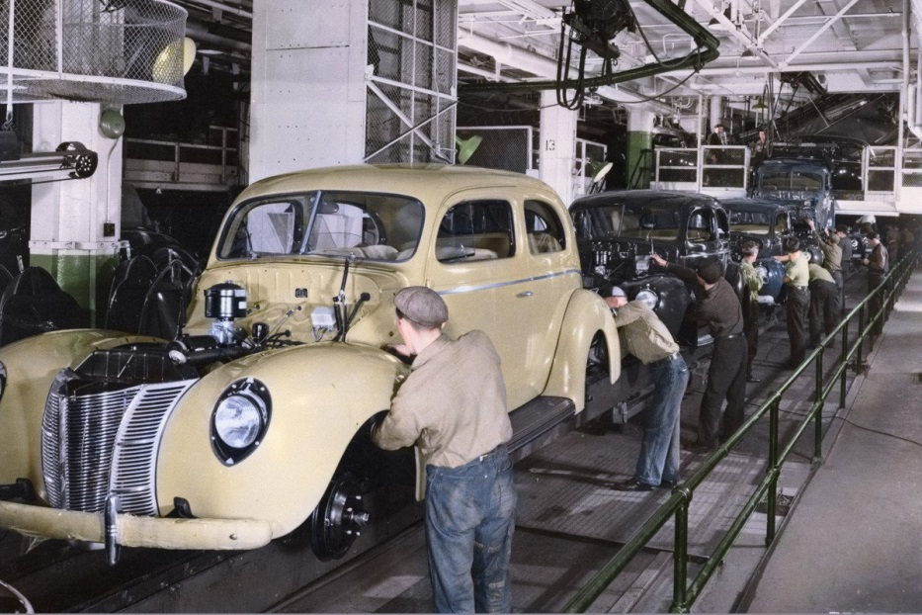
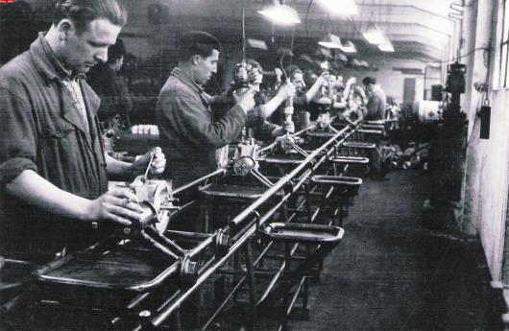
Timing : Critical Modeling Concept
Observation of the system behavior has inherently the concept of time passing by
The model can decide to advance time differently than in the real (world)
  Relation between model timing and real timing has to be always clear
Two dimensions of time: measure perspective, observer perspective
(Reference of) Time measure (metric): defines the units used to “count” time
  Logical time abstract time measured by ticks of a clock embedded in the model
  Real (or physical) time real world time measured by ticks of a physical clocks (wall-clock time)
  Example: fabrication chain (logical: number moves, real: time each move)
Time as perceived by the observer can be seen as (defines the scope of applicability of this time)
  Local time valid only within a component of a system
  Global time valid in the whole system
  Example: fabrication chain (local: time in each phase, global: same time everywhere)

Slide 25
Time Implementation
A model must select its operation at each dimension of timing
The model must know always the correspondence within the time dimensions
The time is kept track with a clock
  The model implements an internal clock to keep track of its timing

Slide 26
Classification of Simulation Models
Static vs Dynamic
  Static representation of a system at a particular time or one that may be used to represent a system in which time plays no role (ex: monte-carlo models)
  Dynamic the system evolves over time
Deterministic vs Stochastic
  Deterministic when the system definition does not contain any probabilistic component (the output is determined once known the input values, although the output value may take long to compute)
  Stochastic when there is at least one random input component, output is also random and must be treated as only an estimate of the true characteristics of the model (how to obtain accurate estimates?)
Continuous vs Discrete
  Continuous if the state changes continuously
  Discrete if the state changes instantaneously at particular instances of time
  (this course focuses on the models marked in red)

Slide 27
Discrete-Event Simulation (DEVS)
DEVS concerns the modeling of the system as it evolves over time by a representation in which the state variables change instantaneously at separate points in time
  The system can change at only countable number of points in time
  These points in time are the times the events occur
  Event is defined as an instantaneous occurrence that may change the state of the system
  Example: car building chain
    Events: put the seats, put the chassis, put the doors, put the wheels….
Time-advance mechanisms
  Must keep track of the current simulated time and how it advances
  Simulation clock is the variable that keeps track of the simulated time
  The unit time for the simulation clock is usually not stated explicitly
    It is the same unit as the input parameters
  There is no relation between simulation time and time needed to execute the simulation

Slide 28
Advancing Time (Update Simulation Clock)
Event-driven simulation: Next-event drives the time advance
  All state changes occur only at event times
  Periods of inactivity are skipped over by jumping the clock from event (activity) to event (activity)
  Time advances in different increments during the simulation run
  (The event actions determine the execution flow)
Time-driven simulation: Fixed-increment time advance
  Time-driven is a special case of event-driven models
  Used when the inactivity periods are accountable in the model
  Time always advances a fix increment; can take longer to run
  All events occurring during this time increment are executed at the end of the interval (less granularity)
  Need to decide the order of the events occurring in the same interval
  Time increment is decided so that these decisions are not critical
  (The clock defines the execution flow)

Slide 29
Event-driven Simulation Components: We’ll learn in practice in the lab assignments
System State | State machine that represents the system
Simulation Clock | Variable of the simulated time
Event List | List of events ordered by simulated runtime
Statistical Counters | Variables of statistical performance
Initialization routine | Sub-program to initialize to time 0
Timing Routine | Determines the next event from the event list and then advances the simulation clock to the time when that event is to occur
Event Routine | Updates the system state when a particular event occurs, there is a different event routine for each type of event
Library Routine | Set of subprograms to generate random observations from probability distributions determined as part of the simulation model
Report Generator | Sub-program that computes estimates (from the statistical counters) of the desired measures performance and produces a report when the simulation ends
Main Program | Sub-program that controls the run time by invoking the timing routine nesting it with event routine to update the state and controls the termination to finally invoke the report generator
In Blue the components of a time-driven simulation

Slide 30
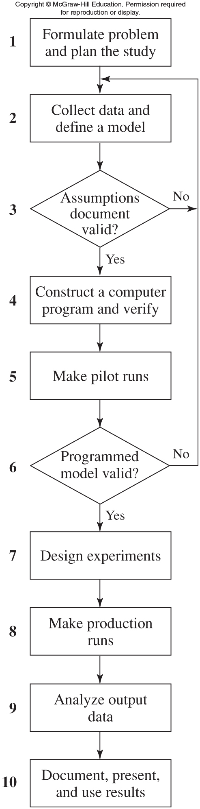
Steps in a Simulation
Study
(flow chart)
P5 - R&SA
Important:
Write assumptions document
P6 – CS (optional)
P3 – RNG
P2 – TDS
P1 – EDS
We’ll go through this process in the course learning the methodology in each step and putting it in practice with lab assignments
P4 – GoR

Slide 31
Steps in a Simulation Study
Model programming is just a part of the overall effort to design or analyze a complex system by simulation
    Formulate the problem and plan the study
    Collect data and define the model (assumptions document)
    Check if the model is valid (if not go back to 2)
    Construct a computer program and verify
    Make Pilot runs
    Verify the correctness of the program (if not go back to 2)
    Design experiments
    Make production runs
    Analyze output data (understand/redesign system)
    Document, present, and use results
The course is structured according to these steps
  Develops primarily steps 4 to 10

Slide 32
What have we learnt?
Terminology: system, model and simulation
Concept of time and dimensions
  Logical / real
  Local / global
Simulation structure: event-driven vs time-driven
  Time is present and very important in both simulation models
Steps involved in a simulation project
  Framework for the rest of the course

Slide 33
Next Steps
Practice with the two simulation models (event vs time) :
  Event-driven Lab 1: supermarket
  Time-driven Labs 2, 4, 5, 6: protocol slotted aloha

